Slide 1
BANK CHURN PREDICTOR (WORKING TITLE)

Slide 2
The day you sign a client is the day you start losing them.
-Don Draper – Mad Men

Slide 3
Roadmap
Draft, let me know if you agree
Topic selection & dataset acquisition
Machine learning models development
Front-end to back-end connection.
1
3
5
2
4
6
Exploratory analysis & Data Wrangling
Front-end development
Product deployment and testing

Slide 4
Topic Selection & Dataset Acquisition
1
Challenges and opportunities with datasets

Slide 5
Why bank churning prediction?
Real
We wanted to develop models with actual business applications.
Applicable
If applied to the right data, the models can work with many different industries besides banks. From health insurance to fitness centres and streaming services.
Reliable
Bank data is expected to be of high quality, particularly for demographic information. Document proof is usually required.

Slide 6
Expected Final Product
A tool that can predict likelihood of a customer leaving the bank:
HTML front end to capture client data
Machine learning model operating in the background
Reliable prediction for any given customer
This tool could be applied in different fields if applied to relevant datasets.

Slide 7
Exploration & Wrangling
2
Diving into the Data

Slide 8
Exploration Outcomes– Basic Information
23 columns
Mostly demographic information
Bank-related data – type of credit card, transactions made, etc.
10127 Rows
No Null values
‘CLIENTNUM’ as Index
Many “Unknown” values

Slide 9
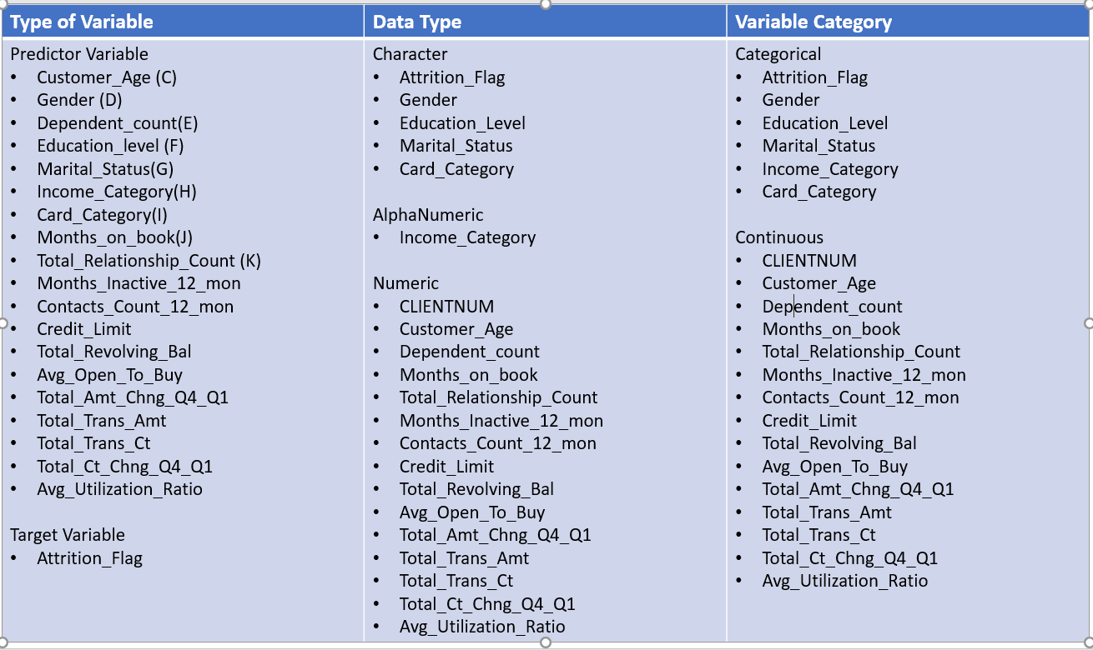
Exploration Outcomes– Variable Identification
Identified type of data and category of each variable
Serves as reference at exploration and execution stages

Slide 10
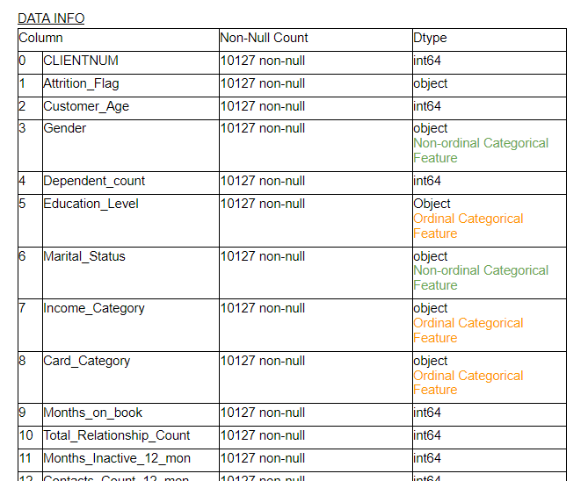
Exploration Outcomes– Univariate Analysis
Basic table with type of data for each column
Serves as reference at exploration and execution stages

Slide 11
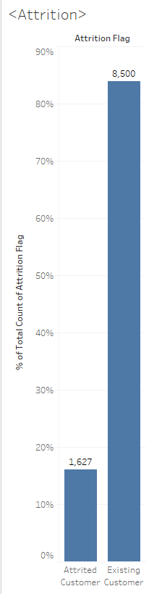
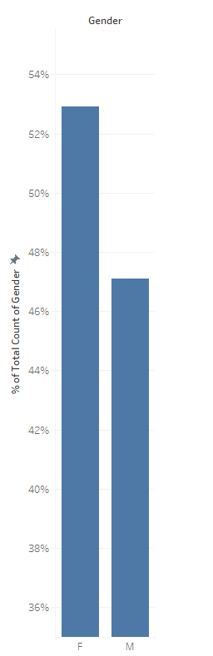
Exploration Outcomes– Univariate Analysis
16% of customers in the data set have closed their accounts.
Gender is slightly biased towards Males, but not significantly.

Slide 12
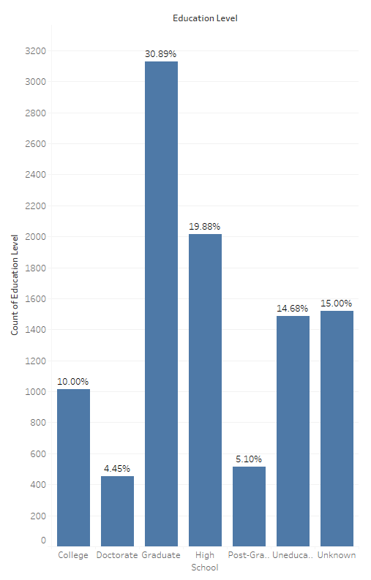
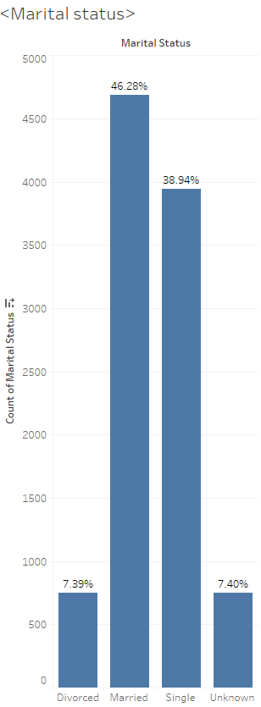
Exploration Outcomes– Univariate Analysis
Education level data is not solid, 15% stated “Unknown”
Similar issue with Marital Status, with 7.4% “Unknown”.
Notes:
Education level data is not solid, 15% stated “Unknown”
Similar issue with Marital Status, with 7.4% “Unknown”.

Slide 13
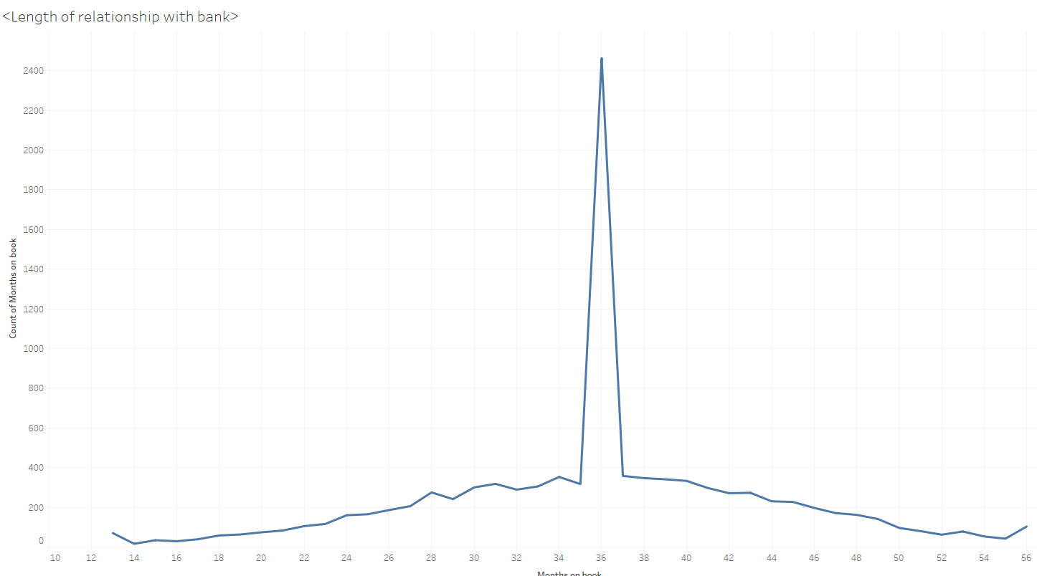
Exploration Outcomes– Univariate Analysis
Notes:
Education level data is not solid, 15% stated “Unknown”
Similar issue with Marital Status, with 7.4% “Unknown”.
Clear bias detected in Length of Relationship – 24.3% of customers have been so for exactly 36 months.

Slide 14
Exploration Outcomes – Univariate Analysis
Clear bias detected in Length of Relationship – 24.3% of customers have been so for exactly 36 months.

Slide 15
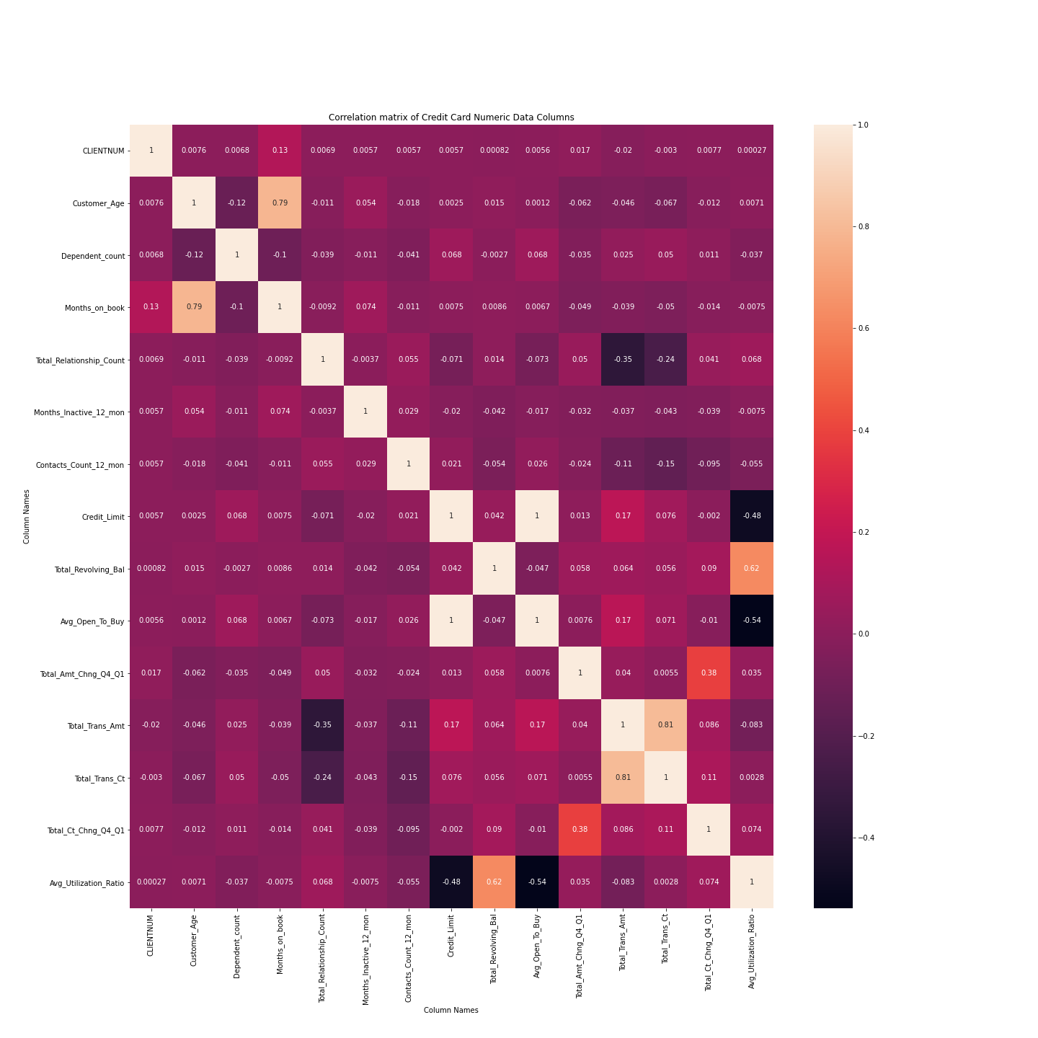
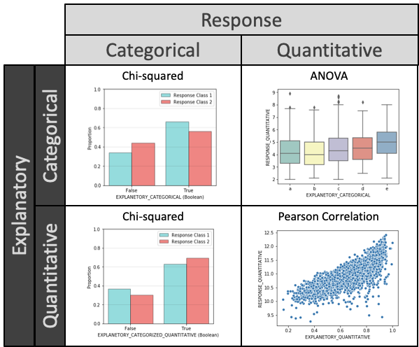
Exploration Outcomes– Multivariate Analysis
Notes:
Correlation Matrix
Applied to all continuous variables
Displays degree of correlation between variables
Analysis of explanatory and response variables

Slide 16
Exploration Outcomes– Multivariate Analysis
Statistical tests
Analysis of explanatory and response variables

Slide 17
Exploration Outcomes– Multivariate Analysis
Correlation Matrix
Applied to all continuous variables
Displays degree of correlation between variables

Slide 18
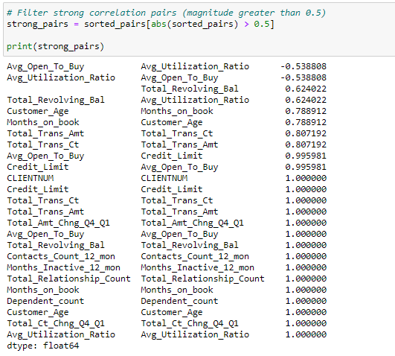
Exploration Outcomes– Multivariate Analysis
Through Pandas, sort pairs of columns based on correlation strength.
Some variables are predictably correlated (eg. “Credit Limit” and “Avg Open to Buy”)

Slide 19
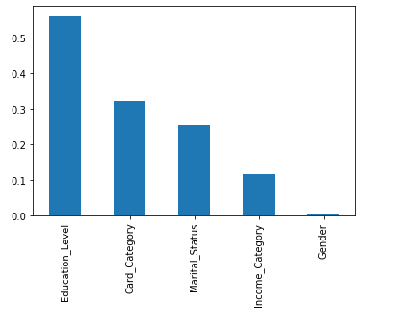
Exploration Outcomes– Multivariate Analysis
Chi-Square Tests
Five category predictors and one category response “Attrition_Flag”
All parameters show p-value>0.05. Variables are independent of the response parameter and can’t be considered for model training.

Slide 20
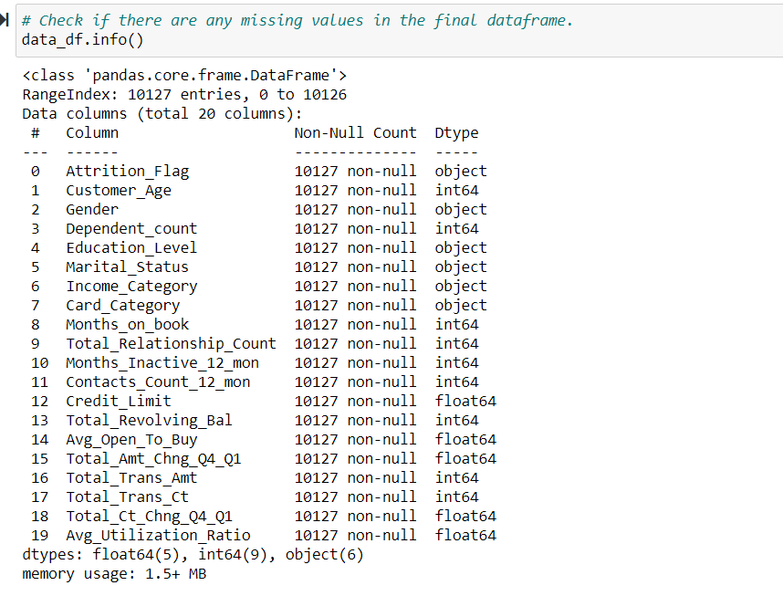
Exploration Outcomes– Missing Value Treatment
No missing values in the dataset

Slide 21
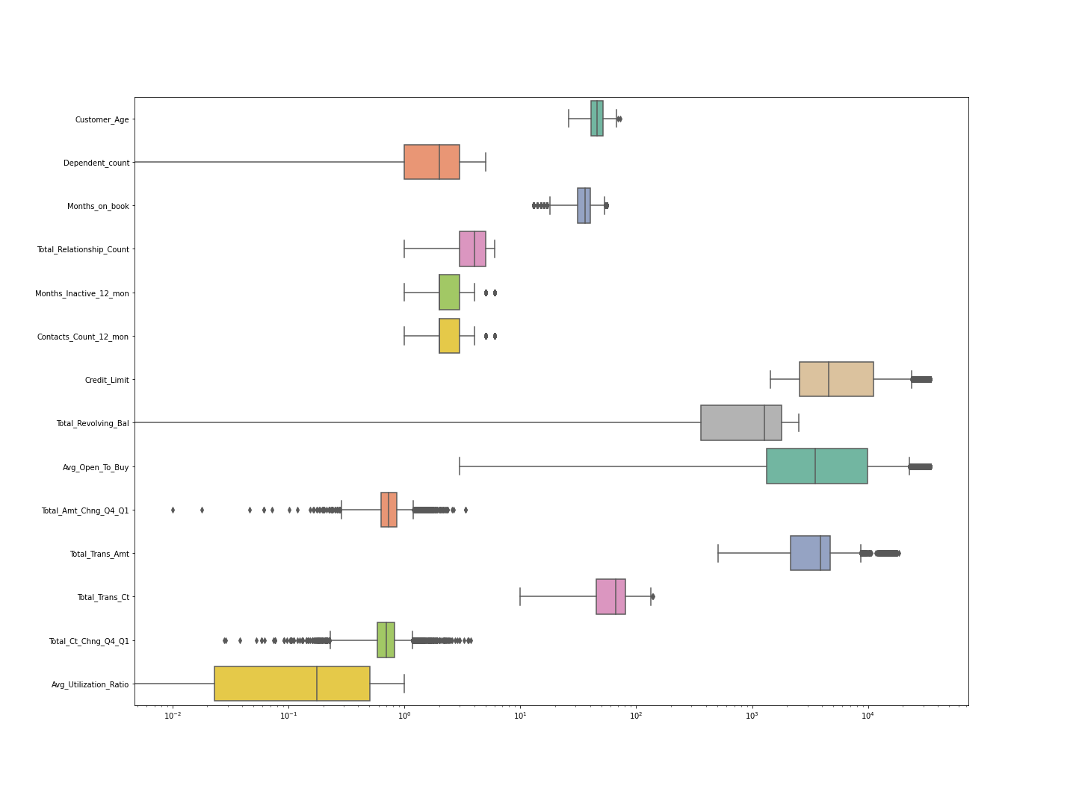
Exploration Outcomes– Outlier Treatment
Many variables show outliers
These outliers seem naturally occurring

Slide 22
Exploration Outcomes– Pre-processing
21 Columns

Slide 23
Exploration Outcomes– Pre-processing
21 Columns

Slide 24
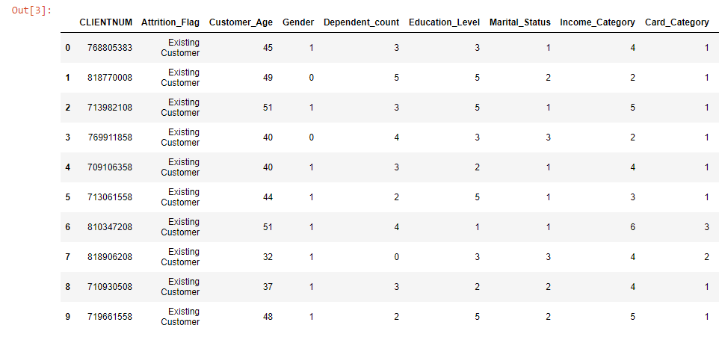
Final Dataset
21 Columns
Fully encoded – using integers to represent categorical features (eg. ranking by income bracket)

Slide 25
Machine Model Development
3
Applying and comparing models

Slide 26
Modelling Approach
Model creation
Random Forest
Logistic Regression
K Nearest Neighbour
Model Selection
Achieved Accuracy
Selection of best option
COMMENTS??

Slide 27
Modelling Approach– Random Forest
Powerful classification model
92.48% Actual Accuracy
27 customers incorrectly predicted out of 359
Most representative code or chart snapshot?

Slide 28
Modelling Approach– Logistic Regression
Resource efficient classification model
88.7% Test model Accuracy
90.16% Training Model accuracy
Comments?
Most representative code or chart snapshot?

Slide 29
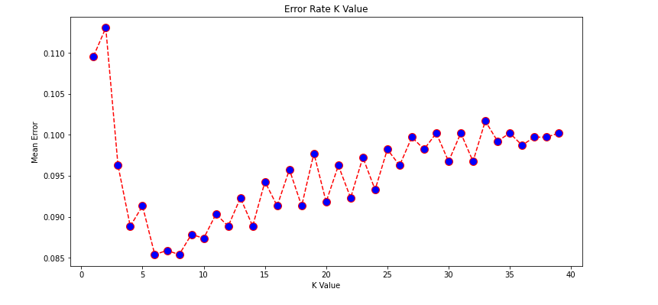
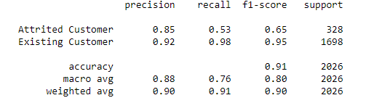
Modelling Approach– K Nearest Neighbour
Straightforward classification algorithm
0.91 F1 Score
How to express the accuracy?
Most representative code or chart snapshot?

Slide 30
Modelling Approach - Conclusion
After comparing model outcomes, we opted for RANDOM FOREST:
Rationale 1
Rationale 2
This model allows us to confidently make predictions.

Slide 31
Front-End Development
4
Making models accesible to users

Slide 32
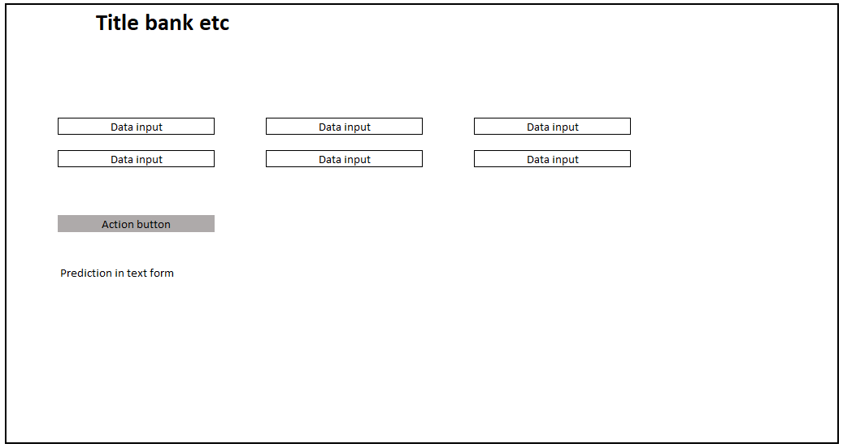
Front-End Development – Early Draft

Slide 33
Front-End Development - Tools
HTML – Web Interface
CSS - Styling
JavaScript & D3 – what exactly?
what else?
Your audience will listen to you or read the content, but won’t do both.

Slide 34
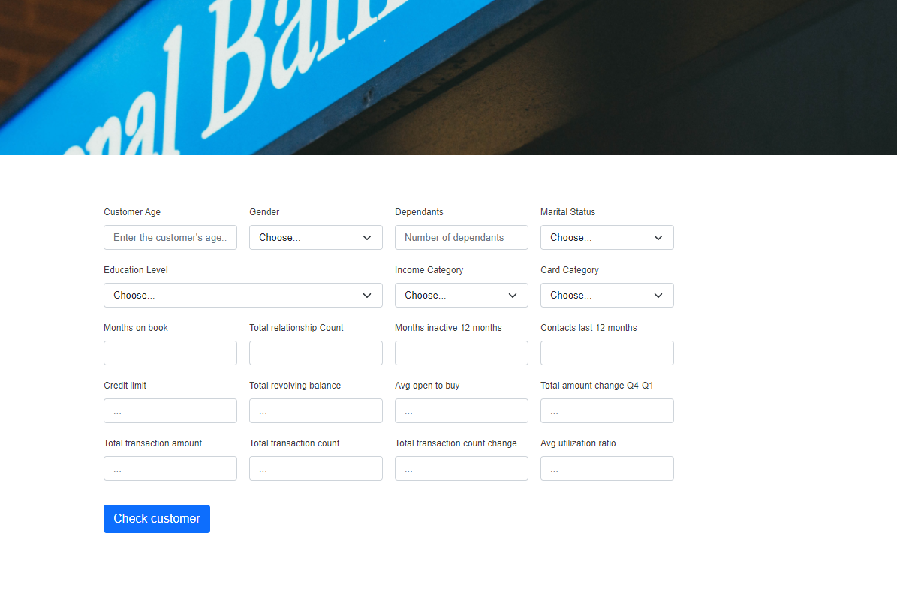
Front-End Development – User Interface
Drop downs for ease of use
Comments?
Button to trigger check
Simple, clean visual identity

Slide 35
Front-End Development – additional content?
Here you have:
Anything else we want to mention?
And some text

Slide 36
Front-End to Back-End Connection
5
Bringing the pieces together

Slide 37
Front-End to Back-End Connection- Tools
Flask – API – anything else?
SQL Alchemy?
Additional tools?

Slide 38
Front-End to Back-End Connection– additional content?
Here you have:
Anything else we want to mention?
And some text or screenshot?

Slide 39
Product deployment and testing
6
Making the final product accesible

Slide 40
Product deployment and testing- Tools
Heroku – have screenshots?
Additional tools?
Screenshots of testing?

Slide 41
CONCLUSION
What is the bottomlime message we want to get across?

